Slide 1
Chapter 8
Sorting

Slide 2
Outline
Basic definitions
Sorting algorithms
Bubble sort
Insertion sort
Selection sort
Quick sort
Shell sort
Merge sort
Example programs

Slide 3
Sorting & related concepts
Sorting: A process of arranging the data items in a data structure to support ascending or descending order of the items.
Typically the data structure is an array.
Why sorting?
Key: When each data item is composed of multiple attributes, one of the attributes must be selected as the “key”.
Sorting is based on comparing the key values of the data items.
Comparability : The key values must be comparable.

Slide 4
Sorting & related concepts
There exist various sorting algorithms
Bubble sort
Insertion sort
Selection sort
Quick sort
Shell sort
Merge sort
…

Slide 5
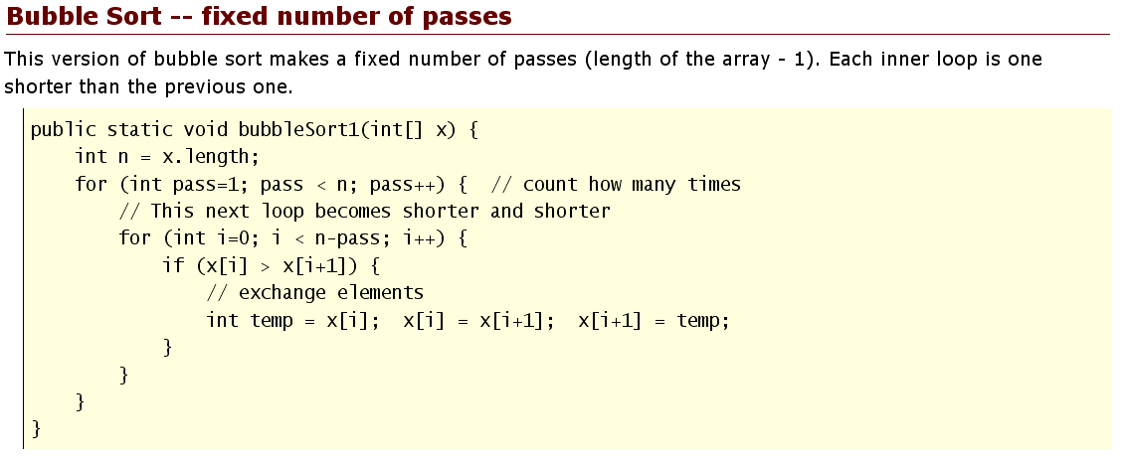
Bubble sort
Source: http://www.leepoint.net/notes-java/data/arrays/32arraybubblesort.html
A simple sorting algorithm of O(N²).
Also called ‘sink sort’. Why?
Exercise: Sort an array of the five items with bubble sort and count the number of comparisons.
Question: How does the ‘sorted section’ grow with each pass?

Slide 6
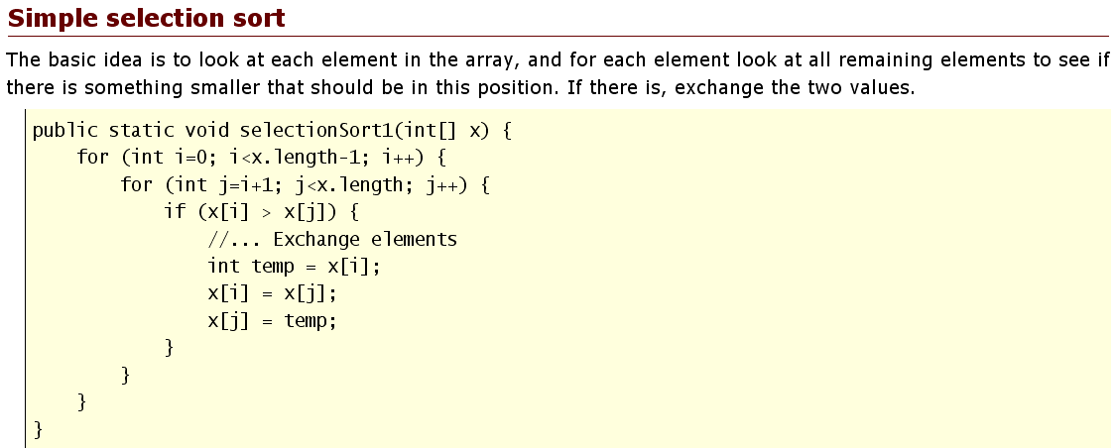
Selection sort
Source: http://www.leepoint.net/notes-java/data/arrays/31arrayselectionsort.html
O(N²)
Exercise: Sort an array of the five items with selection sort and count the number of comparisons.
Question: How does the ‘sorted section’ grow with each pass? Where is the ‘sorted section’ located?

Slide 7
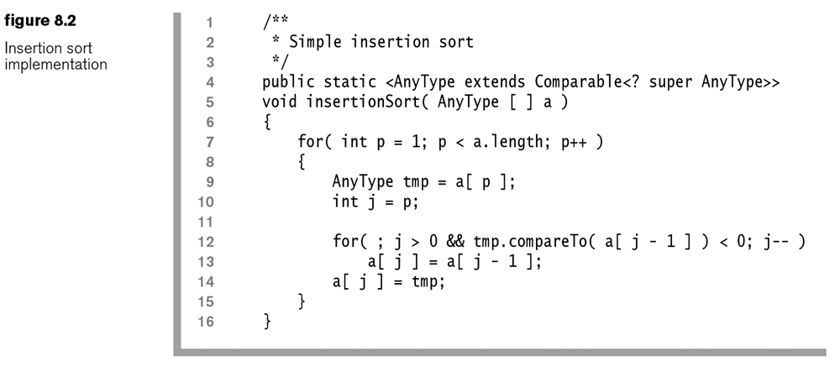
Insertion sort
O(N²)
Only appropriate for small N.
A good algorithm when most items are already sorted.
More efficient in practice than most other simple quadratic algorithms such as selection sort or bubble sort; the best case (nearly sorted input) is O(n).

Slide 8
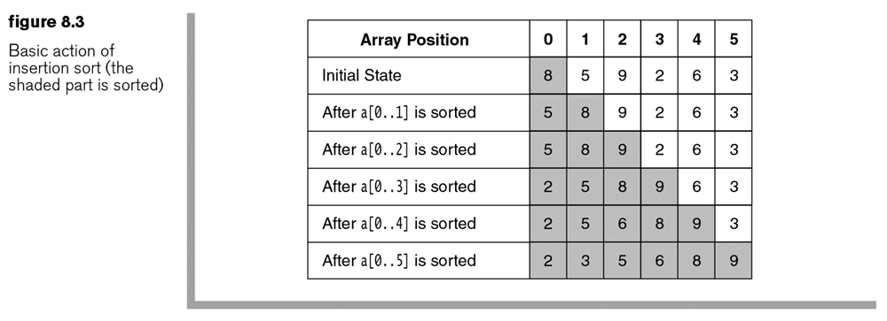
Insertion sort: example

Slide 9
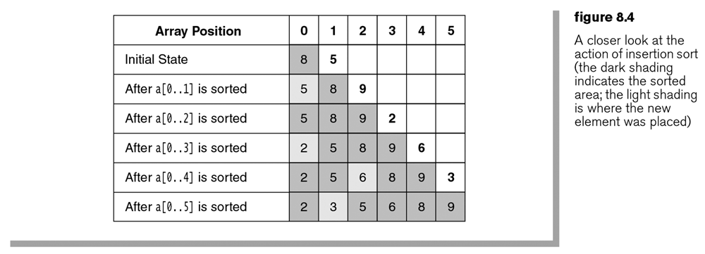
Insertion sort: example

Slide 10
Theorems wrt insertion sort
Theorem 8.1: The average number of inversions in an array of N distinct numbers is N(N-1)/4.
An inversion is a pair of elements that are out of order in an array.
Formally, let A[1..n] be an array of n distinct numbers. If i < j and A[i] > A[j], then the pair (i,j) is called an inversion of A. (http://en.wikipedia.org/wiki/Inversion_%28discrete_mathematics%29)
The number of inversions in an array measures its unsortedness.
For data sets that are already substantially sorted, the time complexity of insertion sort is O(n + d), where d is the number of inversions. That is, the average cost is still O(N²).

Slide 11
Theorems wrt insertion sort
Theorem 8.2: Any algorithm that sorts by exchanging adjacent elements requires time on average.
True for insertion, bubble, and selection sorts, all of which perform adjacent exchanges.

Slide 12
Insertion vs Selection sort
Source: http://en.wikipedia.org/wiki/Insertion_sort
While insertion sort typically makes fewer comparisons than selection sort, it requires more writes because the inner loop can require shifting large sections of the sorted portion of the array.
In general, insertion sort will write to the array O(n²) times, whereas selection sort will write only O(n) times.
Question: Do you agree with the above statement? Is there a way of verifying it?
For this reason selection sort may be preferable in cases where writing to memory is significantly more expensive than reading, such as with EEPROM or flash memory.

Slide 13
Shellsort
Discovered in 1959 by Donald Shell
First algorithm to improve on the insertion sort substantially
A subquadratic algorithm – o(N²)

Slide 14
Shellsort
Shellsort uses a sequence called the increment sequence.
After a phase, using some increment h_{k}, we have for every i where i + h_{k} is a valid index; all elements spaced h_{k} apart are sorted.
The array is then said to be h_{k}-sorted.
Exercise 1: Shellsort the array below using the shellsort() method shown above.
Exercise 2: Repeat the shellsort but use the sequence {1,3,5}. Compare their performance.
Exercise 3: Would the sequence {1,3,7} be better?

Slide 15
Shellsort
Also called diminishing gap sort
For each gap, it performs a gap insertion sort.
When gap becomes 1, it performs exactly the insertion sort.
Question: The shell sort contains three loops. How can it be possible that it’s more efficient than the insertion sort, which contains only two loops?

Slide 16
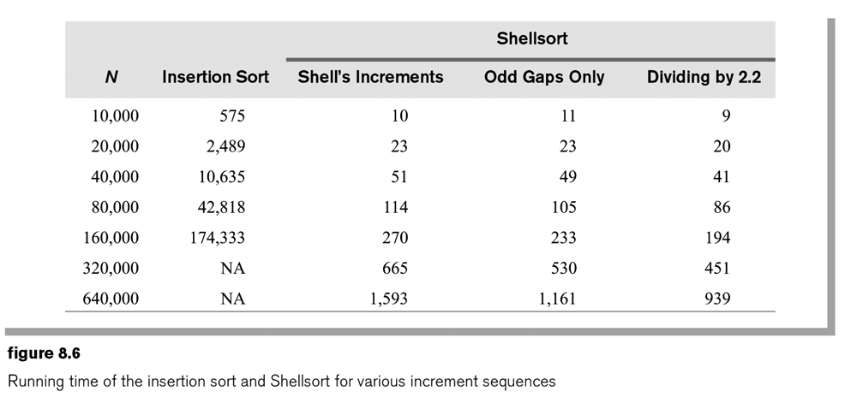
Shellsort
The running time of Shellsort depends heavily on the choice of increment sequences.
Better sequences (than what Shell proposed) are known.
Odd gaps only: When the gap is even, add 1 to it.
Divide the gap by 2.2, instead of 2 as in the Shell’s increments

Slide 17
Quicksort
A divide-and-conquer algorithm
Average running time is O(N logN)
Worst case: O(N²), but can be avoided by choosing the pivot right
The basic idea:
Given a set of items, choose one of them as the pivot, p.
Partition the items into three groups: those that are larger than p (L), those that are smaller than p (R), and those that are the same as p (S).
Continue the same process with L and R to sort them.
When done, combine L, S, and R.

Slide 18
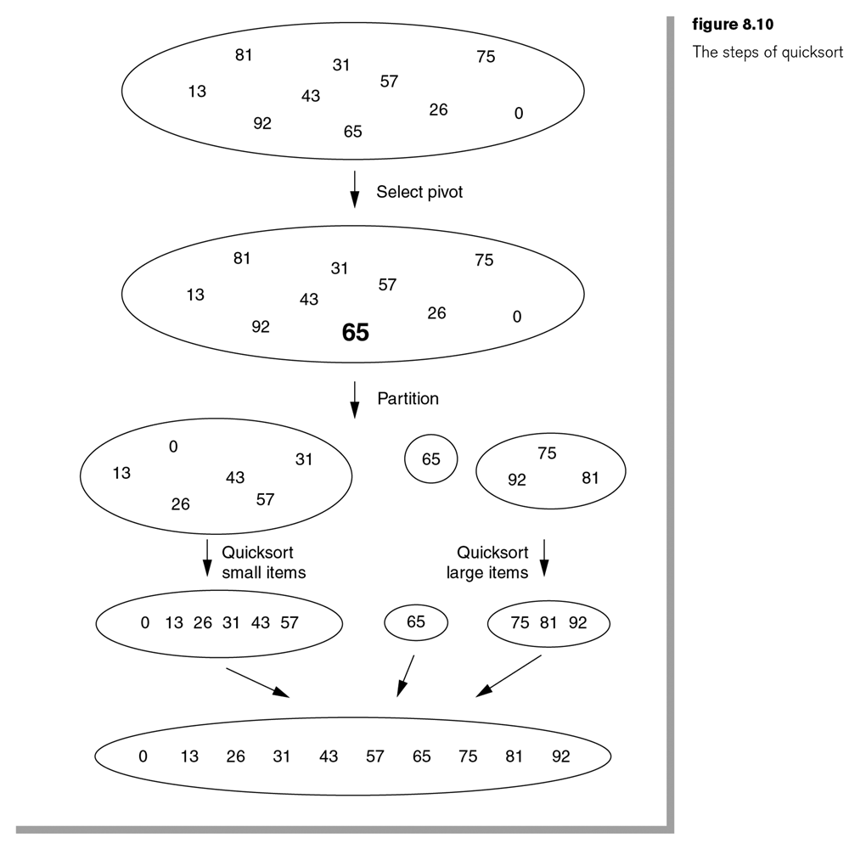
Quicksort
Basic process

Slide 19
Quicksort
The basic algorithm Quicksort(S):
If the number of elements in S is 0 or 1, then return. //base condition
Pick an element v in S. It is called the pivot.
Partition S – { v} ( the remaining elements in S) into two disjoint groups: L = {x in S-{v} <= v} and R = {x in S-{v} >= v}.
Return the result of Quicksort(L) + v + Quicksort(R).

Slide 20
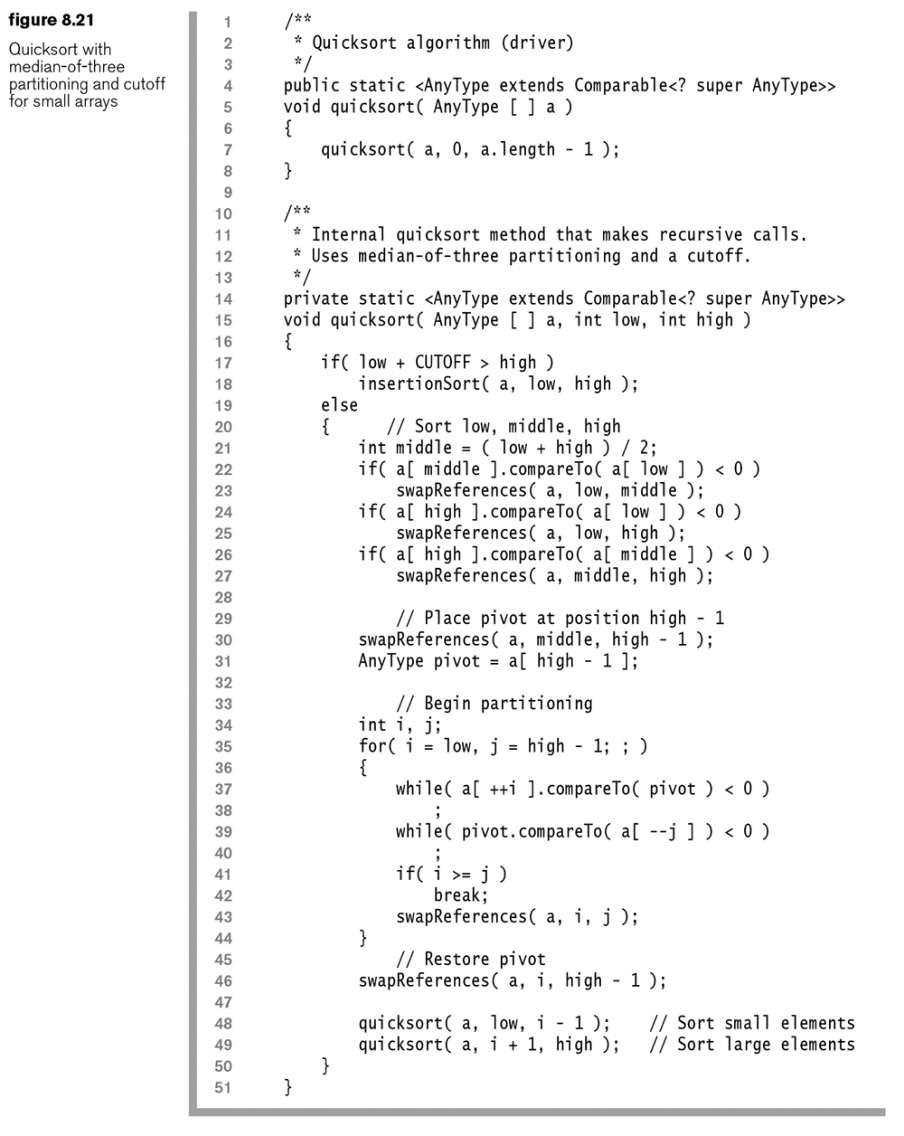
Example implementation
Quicksort (a[ ], low, high)
If size(a) < CUTOFF then insertionSort (a,low,high);
Else
Sort the low, middle, high elements
Choose the middle as the pivot
Place the pivot at the high-1 position
Partitioning the range from low to pivot-1:
Search from low toward the pivot until an item >= the pivot is found (let i = the index of that item)
Search from the pivot down toward low until an item <= the pivot is found (let j = the index of that item)
Place the pivot to the right position, i.
Quicksort (a, low, i-1)
Quicksort (a, i+1, high)

Slide 21
Quicksort: example
Index | a [ ]
0 | 170
1 | 200
2 | 150
3 | 500
4 | 210
5 | 220
6 | 100
Mid = | 3
Pivot =
i =
j =

Slide 22
Quicksort: example
Index | a [ ]
0 | 500
1 | 150
2 | 220
3 | 100
4 | 150
5 | 200
6 | 150
Mid = | 3
Pivot =
i =
j =

Slide 23
Analysis of quicksort
Best case: O(N logN)
In each phase, the pivot partitions the set into two equally sized subsets (logN)
Each phase incurs linear overhead (N)
Worst case: O(N²)
When the smallest (or the largest) element is chosen as the pivot
Average case: O(N logN)

Slide 24
Exercises
Ex 8.1: Sort the sequence 8,1,4,1,5,9,2,6,5 using
Insertion sort
Shellsort for the increments {1,3,5}
Quicksort, with the middle element as the pivot and no cutoff (show all steps)
Quicksort, with median-of-three pivot selection and a cutoff of 3

